Slide 1
Data Storage Mechanisms

Slide 2
OLTP vs OLAP
Data Warehouse
Data Mart
Data Lake
Data Island

Slide 3
OLTP
Online Transaction Processing.
ERP, CRM, banks, ATMs, etc.
High transactional activity (inserts, updates, deletes) mean few indexes.
System responds immediately to user requests.
High level of throughput.
Not efficient at querying.
Relatively small dataset.
Supports day to day operational business processes.

Slide 4
Online Analytical Processing.
Data loaded in bulk (historical and current).
Low transactional activity.
Allows many indexes.
Typically read-only.
Designed to allow very efficient querying.
Large dataset capability.
Supports analysis of the data for enterprise level decision making.
OLAP

Slide 5
 | OLTP | OLAP
Sources | OLTP system itself | OLTP systems across the enterprise
Purpose | Day to day operational tasks | Enterprise decision making, planning and problem solving
Data operations | Read, write, update, delete | System refreshes – mainly read-only with some write
Queries | Simple, return small datasets | Complex, return large datasets – mainly aggregations
Design | Highly normalised | Less normalised – star schema
Integrity | Integrity needs to be maintained | Integrity to a lesser degree as read-only and refreshed
Database Transactions | Short, quick transactions due to small amounts of data handled in each transaction | Longer transactions due to heavy number crunching across many rows
Users | Data entry staff, customer service, DB admins | Executives, management team, analysts
OLTP vs OLAP

Slide 6
Collects data over a period of time.
(Usually) collects data from multiple data sources.
Is supported by ETL processes (extract, transform and load).
Has a different structure to typical OLTP database.
Supplies analytical information to key stakeholders to aid decision-making.
Offers multiple levels of aggregation.
Data Warehouse is an OLAP mechanism

Slide 7

Scenario: Organisation which manufactures and sells goods
Types of OLAP queries
Number of Products sold by Year
Number of Products manufactured by Location
Total Revenue of products sold by Customer Type
Number of Products manufactured by Product Type
Total Profit generated in the Last Month
Cost of Products manufactured by Product Line
Total Revenue of Products sold by Sales Person and Sales Region
Measures (aggregates)
Dimensions (descriptive)

Slide 8
Telephone Sales
Data Warehousing
Internet Sales
ETL
Data
Warehouse
Purchasing
Production
Disparate applications/data sources
Accounts
Processed via Extract/Transform/Load
Integrated into Data Warehouse

Slide 9




The data warehouse can feed selected, relevant data to localised data centres called data marts.
Data Marts
Data
Warehouse
Sales and Marketing
Quality Control
Management
Information
Planning

Slide 10




end user interactions
Data
Warehouse
Data Mart
Dashboards
Data Mining and Analytics
Planned
Management
Reports
Custom
Reporting

Slide 11
So, what are the steps for implementing a data warehouse?

Slide 12


A data warehouse consists of:
Dimensions - Things we group data by
Categories
Customer, Product, Country, Location
Time
Year, Quarter, Month, Week, Day
Measures (Facts) - Almost always numeric
Count of
Sum of
Average of
Data Warehouse Design Definitions

Slide 13
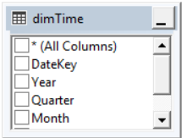
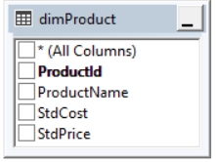
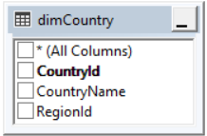
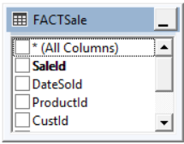
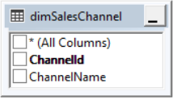
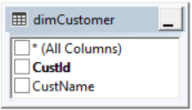
Star Schema
Notes:
Star schema dimensions are more de-normalised than OLTP databases; less joins, faster queries
Long thin fact tables make for fast aggregations (sums and counts)
Disadvantages:
Less flexible than normalised designs. With normalised designs you can run any query by joining any tables together; star schemas are designed once the reporting requirements have been gathered
e.g. Simple query to count customers or products is not done with a star schema has it’s centred around events ‘orders placed’ etc.
Normalised designs have DRI built into them. This is often lacking in star schemas due to de-normalised nature of the table

Slide 14
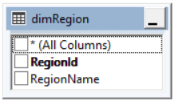
Snowflake Schema
Linking a dimension via another dimension instead of the fact table turns a star schema into a snowflake schema.

Slide 15
Aspect | Star schema | Snowflake schema
Ease of maintenance | Has redundant data so less easy to maintain | No duplicates so easier to maintain
Query performance | Faster as less joins | Slower due to additional joins
Ease of use | Less joins so queries are easier to understand | More joins so queries are more complex
Space | More space required due to redundant data | Less space needed due to more normalised data
When to use | When there are many levels in a hierarchy better to denormalise to reduce number of joins | If number of levels in hierarchy is few, then snowflake may be a better option
Star vs Snowflake

Slide 16
From ER models to star schema – a process…

Slide 17
Normalised Model for Operational Source System (OLTP)
Sale
SaleID
SaleDate
ProdID
CustID
LocID
SaleValue
Location
LocID
LocTypeID
RegionID
LocName
Location
Type
LocTypeID
LocTypeName
Product
ProdID
ProdName
ProdDesc
ProductType
ProdTypeID
ProdTypeName
State
StateID
StateCode
StateName
Region
RegionID
RegionName
Customer
CustID
CustName
RegionID
CustTypeID
CustomerType
CustTypeID
CustType
Notes:
We design a star/snowflake using a normalised OLTP design as a starting point. This slide represents the starting point. The next few slides describe the process to design from here.

Slide 18
Using the OLTP design as a start point, identify transaction entities.
An event at a point in time.
Contains measurements or quantities (facts).
Become the fact tables.
Identify component entities.
Directly related to transaction entity.
These entities answer questions like who, what, when, why, how.
These become the dimension tables.
The when becomes a date dimension.
Identify classification entities.
Related to component entities by chain of 1:M relationships.
Form a natural hierarchy in the ER data model.
Can be collapsed (denormalised) into existing dimensions or held explicitly as separate dimensions.
The Process to Design from OLTP to OLAP

Slide 19
Location
LocID
LocName
LocTypeID
LocTypeName
RegionID
RegionName
StateID
StateName
Product
ProdID
ProdName
ProdDesc
ProdType
Resulting
Star Schema
Sale
SaleID
DateID
ProdID
CustID
LocID
SaleValue
Customer
CustID
CustName
CustTypeID
CustType
RegionID
RegionName
StateID
StateName
Date
DateID
Date
Day
Week
Month
Qtr
Year
Notes:
Items in yellow highlight the attributes that have been denormalised into a flattened structure.
Date dimension is also added as a new entity.

Slide 20
ETL is an acronym for Extract, Transform, and Load. It's the process that takes data from one or more source systems, transforms and cleanses that data, and loads the result into the data warehouse.
Once we know what data we want to pull into the data warehouse and the destination tables for that data, we can add in some extra information to the data warehouse destination tables such as:
Start times.
End times.
This meta data can be useful as it can:
Be used to alert us to problems.
Allow us to plan for future capacity.
Extraction, Transformation and Load (ETL)
Notes:
Notes to add:
Data Extraction
Clearly identify all the internal data sources. Specify all the computing platforms and source files from which the data is to be extracted. If you are going to include external data sources, determine the compatibility of your data structures with those of the outside sources. Also indicate the methods for data extraction.
Data Transformation
Many types of transformation functions are needed before data can be mapped and prepared for loading into the data warehouse repository. These functions include input selection, separation of input structures, normalization and denormalization of source structures, aggregation, conversion, resolving of missing values, and conversions of names and addresses. In practice, this turns out to be a long and complex list of functions. Examine each data element planned to be stored in the data warehouse against the source data elements and ascertain the mappings and transformations.
Data Loading
Define the initial load. Determine how often each major group of data must be kept up-to-date in the data warehouse. How much of the updates will be nightly updates? Does your environment warrant more than one update cycle in a day? How are the changes going to be captured in the source systems? Define how the daily, weekly, and monthly updates will be initiated and carried out. If your plan includes real time data warehousing, specify the method for real time updates.

Slide 21

Data Lake
System or repository of data stored in its natural format (object blobs or files).
Usually a single store of all enterprise data including raw copies of source system data.
Can also include transformed data used for tasks such as reporting, visualisation, analytics and machine learning.

Slide 22
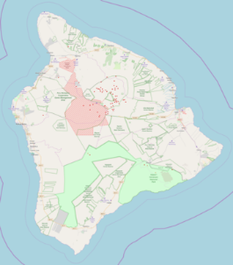
Data Island
System with limited or no external connectivity to other systems.
Acts primarily as a data store.
USB drive.
Standalone documents (xlsx).
User is limited in their ability to update or synchronise the data with other systems.
Term also used to describe data tables that are unlinked to any other table in a database.
Standalone reference or lookup table.

Slide 23
Guided activity to implement a simple data warehouse

